Slide 1
Topic: Ratios EQ: How do I divide quantities into ratios?
Year 11 Essentials

Slide 2
Things Required For This Lesson
Interactive Notebook
Textbook: Interleaved Maths Essential Connections
Ruler, Red Pen, Pencil, Pens, Scientific Calculator
Growth mindset

Slide 3

24
7
30
Topic: Ratios
Date: /03/2021
EQ: How do I divide quantities into ratios?
WICOR
This Photo by Unknown Author is licensed under CC BY-SA

Slide 4
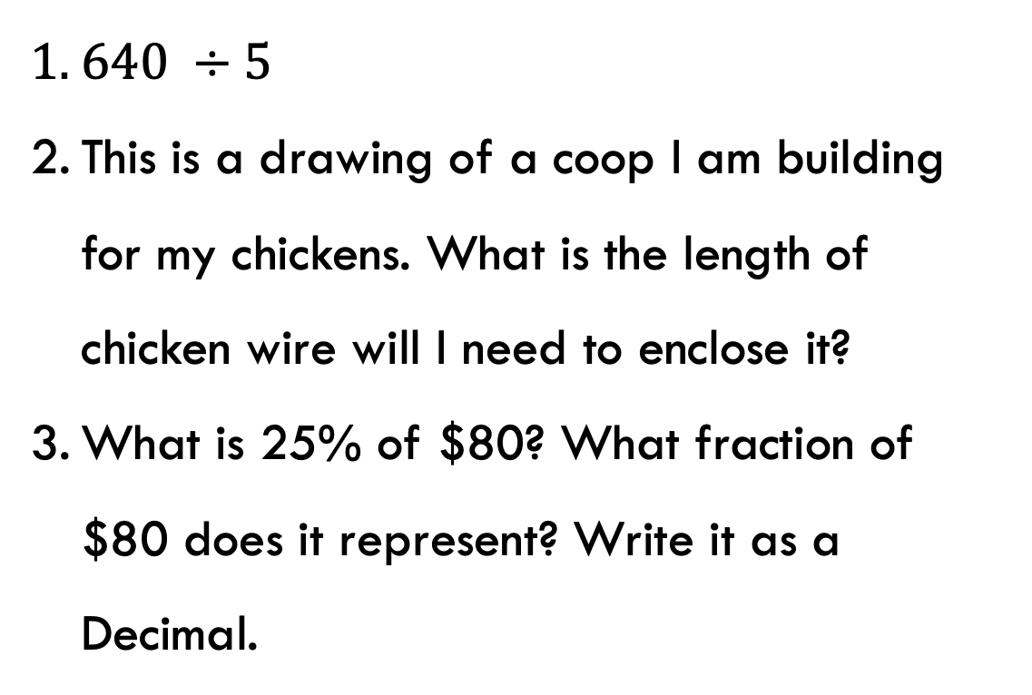
Topic: Ratios
EQ: How do I divide quantities into ratios?
Interleaved Questions
$640 ÷5$
This is a drawing of a coop I am building for my chickens. What is the length of chicken wire will I need to enclose it?
What is 25% of $80? What fraction of $80 does it represent? Write it as a Decimal.
Q2. Not to scale.
7m
3.5m
3.6m
1.8m

Slide 5
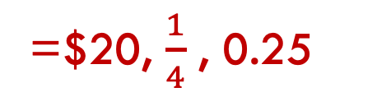
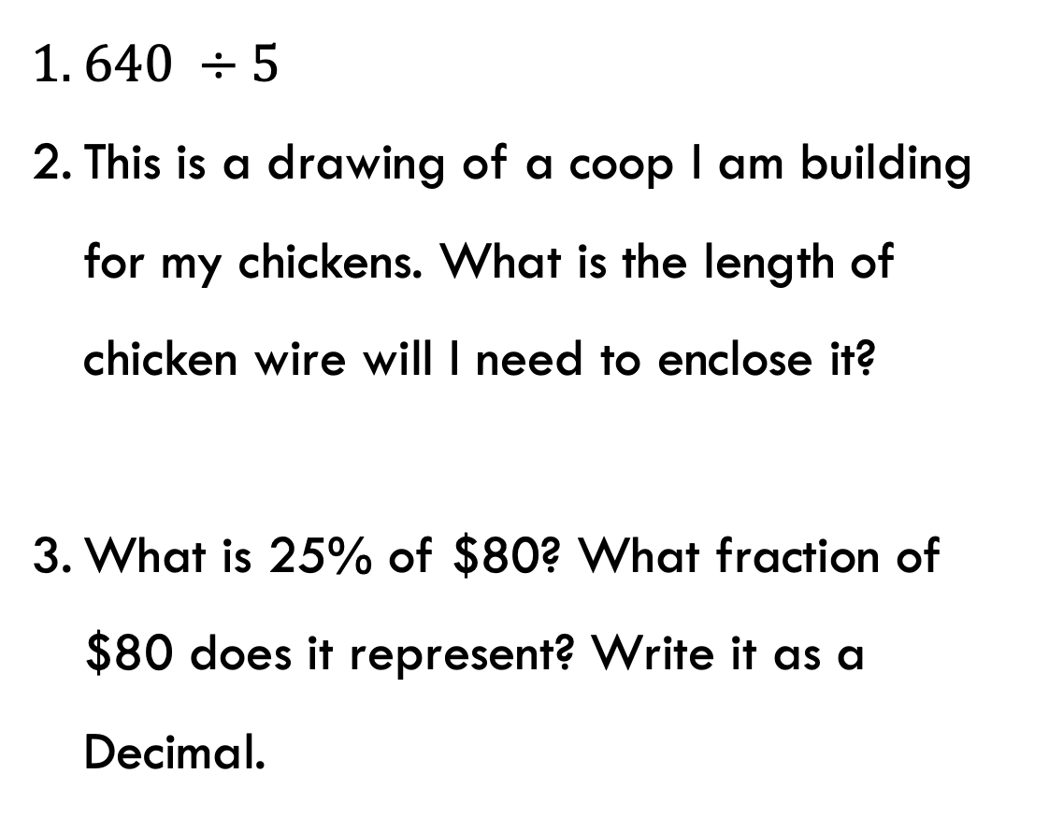
Topic: Ratios
EQ: How do I divide quantities into ratios?
Interleaved Questions
$640 ÷5$
This is a drawing of a coop I am building for my chickens. What is the length of chicken wire will I need to enclose it?
What is 25% of $80? What fraction of $80 does it represent? Write it as a Decimal.
=128
Q2. Not to scale.
7m
3.5m
3.6m
1.8m
=21.2m
=$20, $\frac{1}{4}$ , 0.25

Slide 6

24
7
30
Topic: Ratios
EQ: How do I divide quantities into ratios?
What is dividing quantities?
Use the total number of items and a ratio to work out how many items there will be in each type. This is called dividing quantities into ratios.
Total number of items ($8+6+1=15$)
Red:Yellow:Blue Ratio of 8:6:1
Red | Yellow | Blue | Total
8 | 6 | 1 | 15
WICOR
Notes:
In the introductory lesson on ratios, the last question ask you to work out how many of each colour lolly there would be when you knew how many lollies were in the baf and the ratio of colours.

Slide 7
Think pair share
Discuss similarities and differences between the question given and the table.
Q: In a cricket match, three batsmen A, B and C together scored 210 runs in one innings. If the runs scored by them be in the ratio 6 : 7 : 8 respectively then find the runs scored by B.
A | B | C | Total
6 | 7 | 8
 |  |  | 210
Notes:
Discuss partitioning strategy – breaking up a rectangle into parts shows that the discount is 5 out of 50 which calculates to a 10% discount

Slide 8


24
7
30
Topic: Ratios
EQ: How do I divide quantities into ratios?
How to use a relationship table to solve ratios?
Q: A bag of lollies has a ratio of red:yellow:blue of 4:3:2. If there was 36 lollies altogether how many would there be of each colour?
Red | Yellow | Blue | Total
4 | 3 | 2
 |  |  | 36
9
$$×4$$
16
12
8
Add up the numbers in the original ratio, what is the total?
2. How is that number related to 36?
$$36 ÷9=4$$
3. Use that number to the other numbers in the ratio.
e.g 4x4= 16
3x4= 12
2x4= 8
WICOR

Slide 9
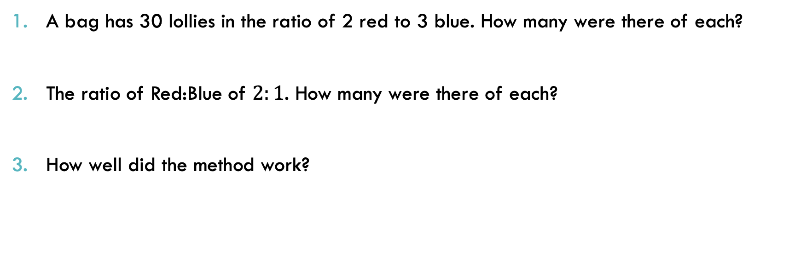
Practice: (LHS)
Answer the following questions using the relationship table.
A bag has 30 lollies in the ratio of 2 red to 3 blue. How many were there of each?
The ratio of Red:Blue of $2:1$. How many were there of each?
How well did the method work?

Slide 10
Practice: (LSH)
Task
1. Complete the Extend Question on page 33
2. Complete the Explain Question (in your own words) on page 33

Slide 11
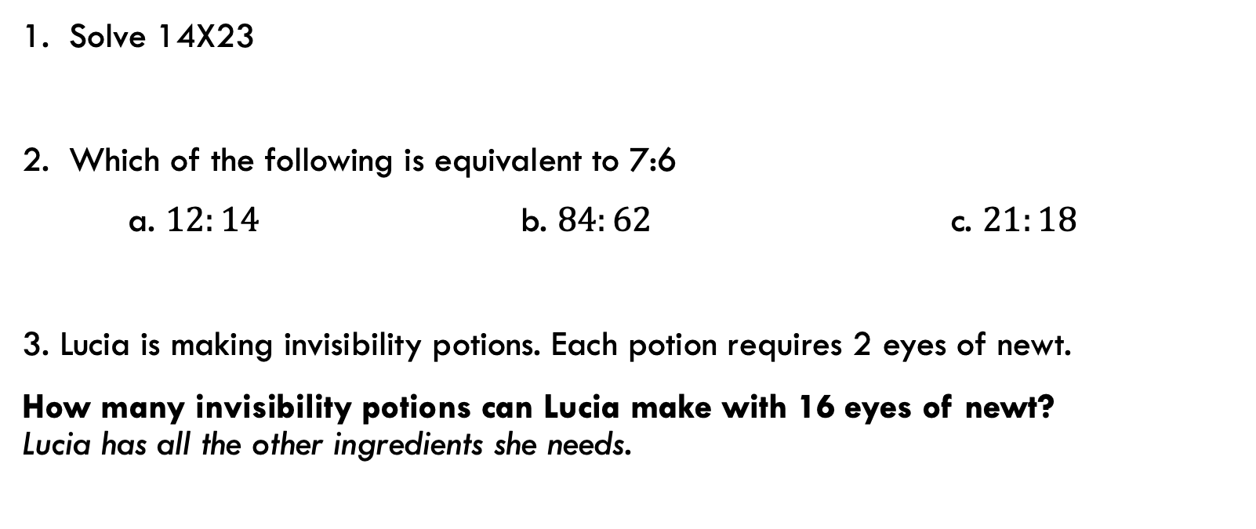
Exit Pass
1. Solve 14X23
2. Which of the following is equivalent to 7:6
a. $12:14$ b. $84:62$ c. $21:18$
3. Lucia is making invisibility potions. Each potion requires 2 eyes of newt.
How many invisibility potions can Lucia make with 16 eyes of newt? Lucia has all the other ingredients she needs.

Slide 12

Thank you
Keep up the good work!
”Its up to you how far you go. If you don’t try, you’ll never know.
-Merlin the Sorcerer.

